Slide 1

Introducing {workboots}
Generate prediction intervals from tidymodel workflows
Mark Rieke
@markjrieke
2022-07-27
<link to slides>
Notes:
Hi everyone! Thank you for coming to my talk. My name is Mark Rieke and today I’ll be introducing workboots, which is a package for generating prediction intervals from a tidymodel workflow.
Before we get into that, I want to talk about tools!
I do a lot of home improvement projects, so I’ve seen a wide variety of *interesting* tools

Slide 2


Slide 3
paint brush with bluetooth

Slide 4
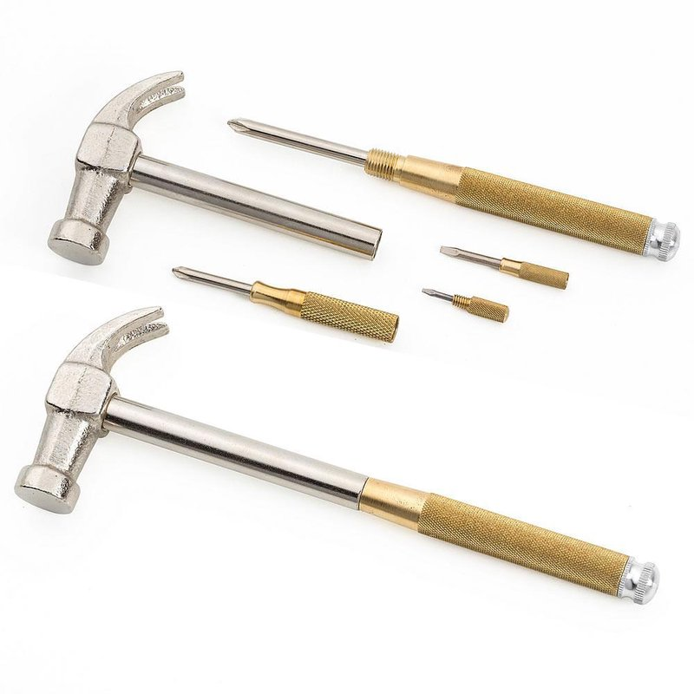

Slide 5
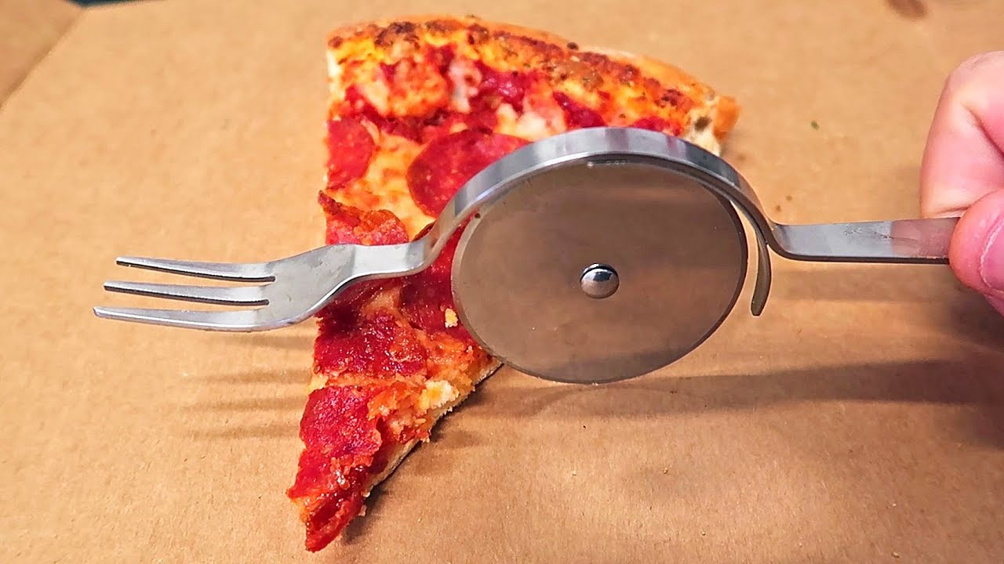

Slide 6
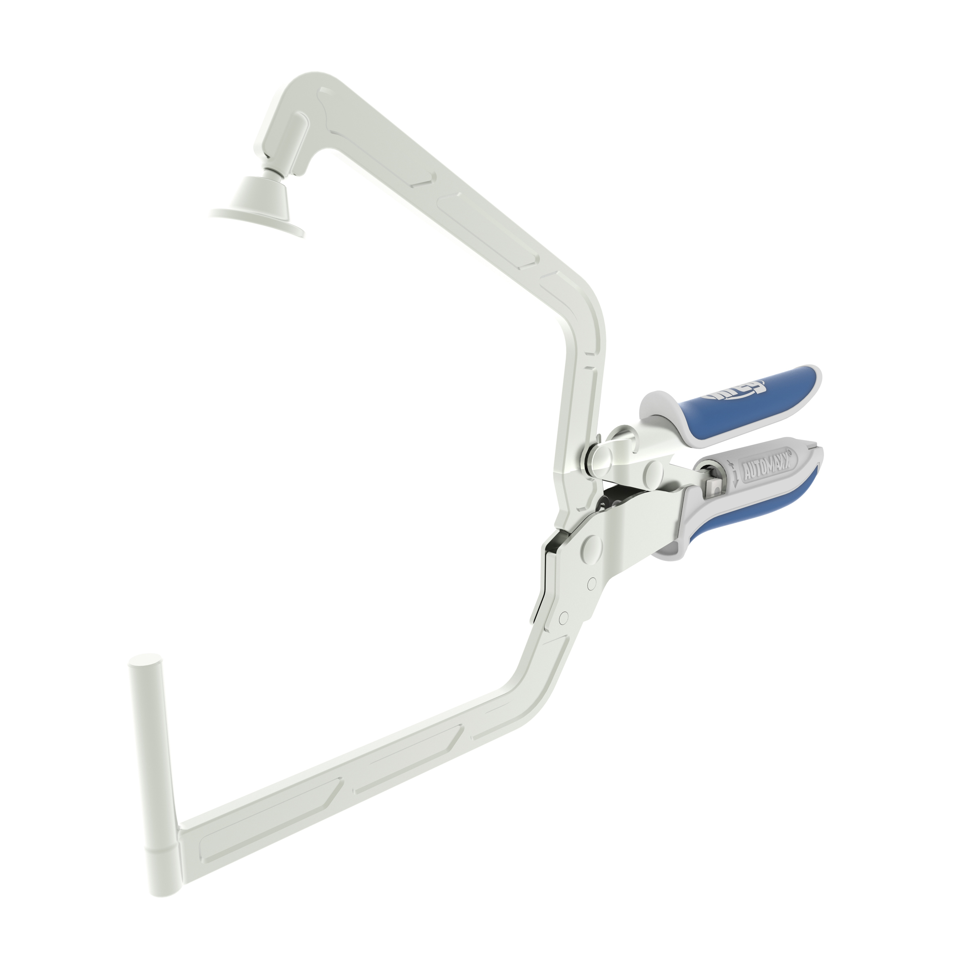
Update with mine later

Slide 7
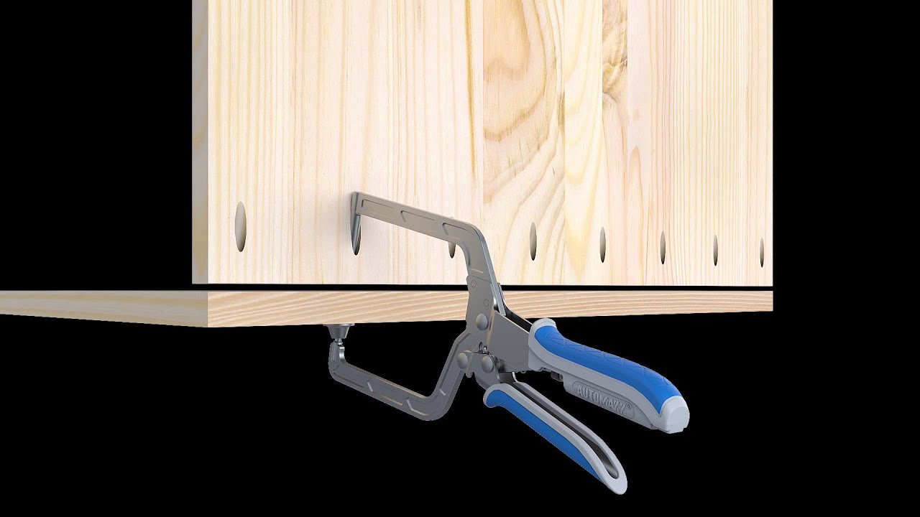
Update with mine later
Notes:
“Right tool for the right job”

Slide 8
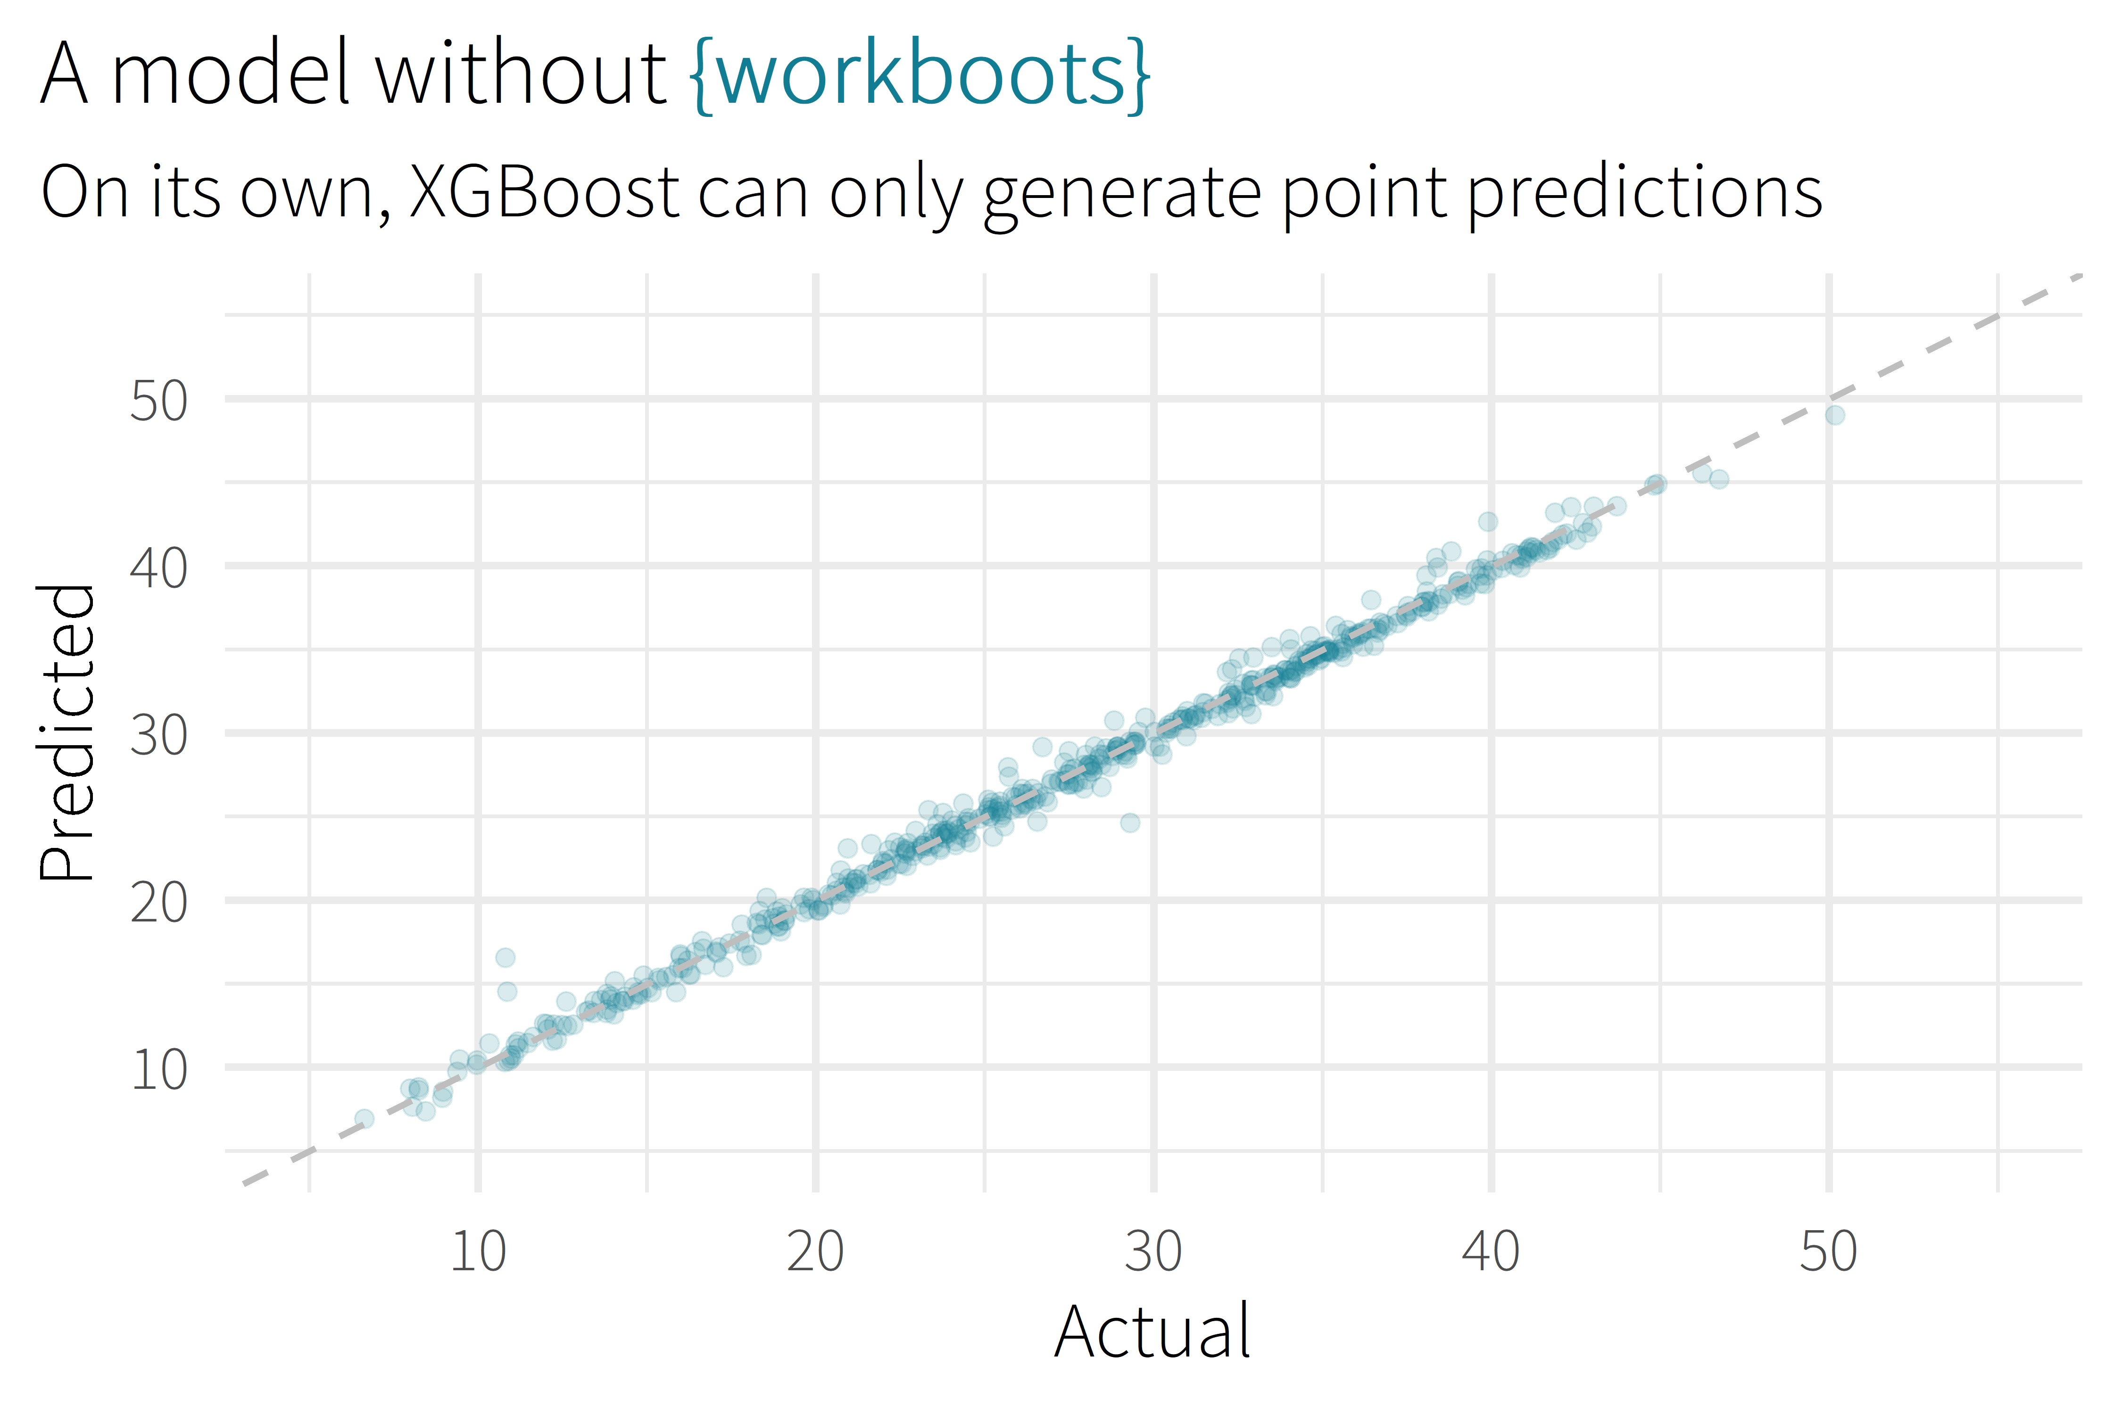

Slide 9
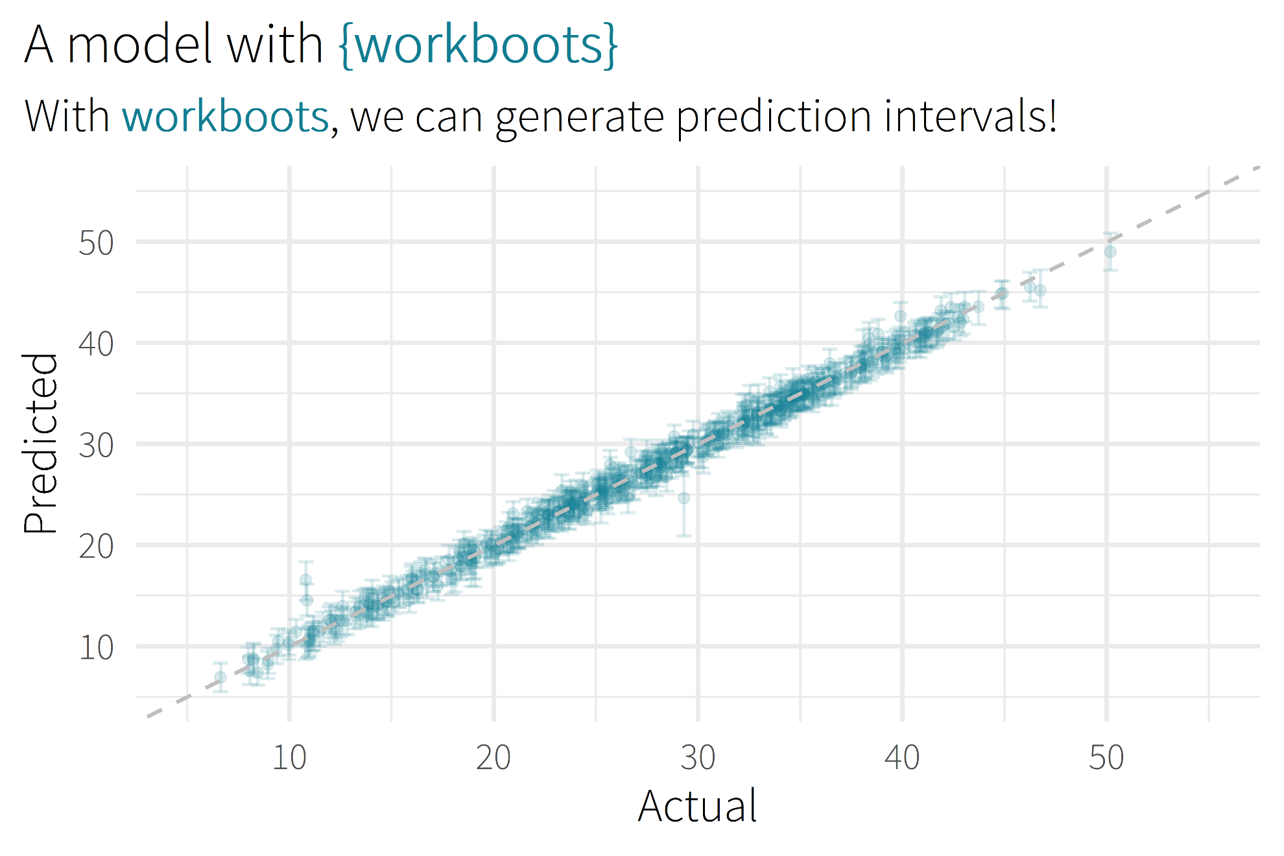

Slide 10

Motivation/Background

Slide 11
background
Why you might want to use? (role as analyst)
Checks to hit before use

Slide 12
about me
Sr. CX Analyst, MHHS
As;ldkfjas;dlkfjasd;lkfjasd

Slide 13
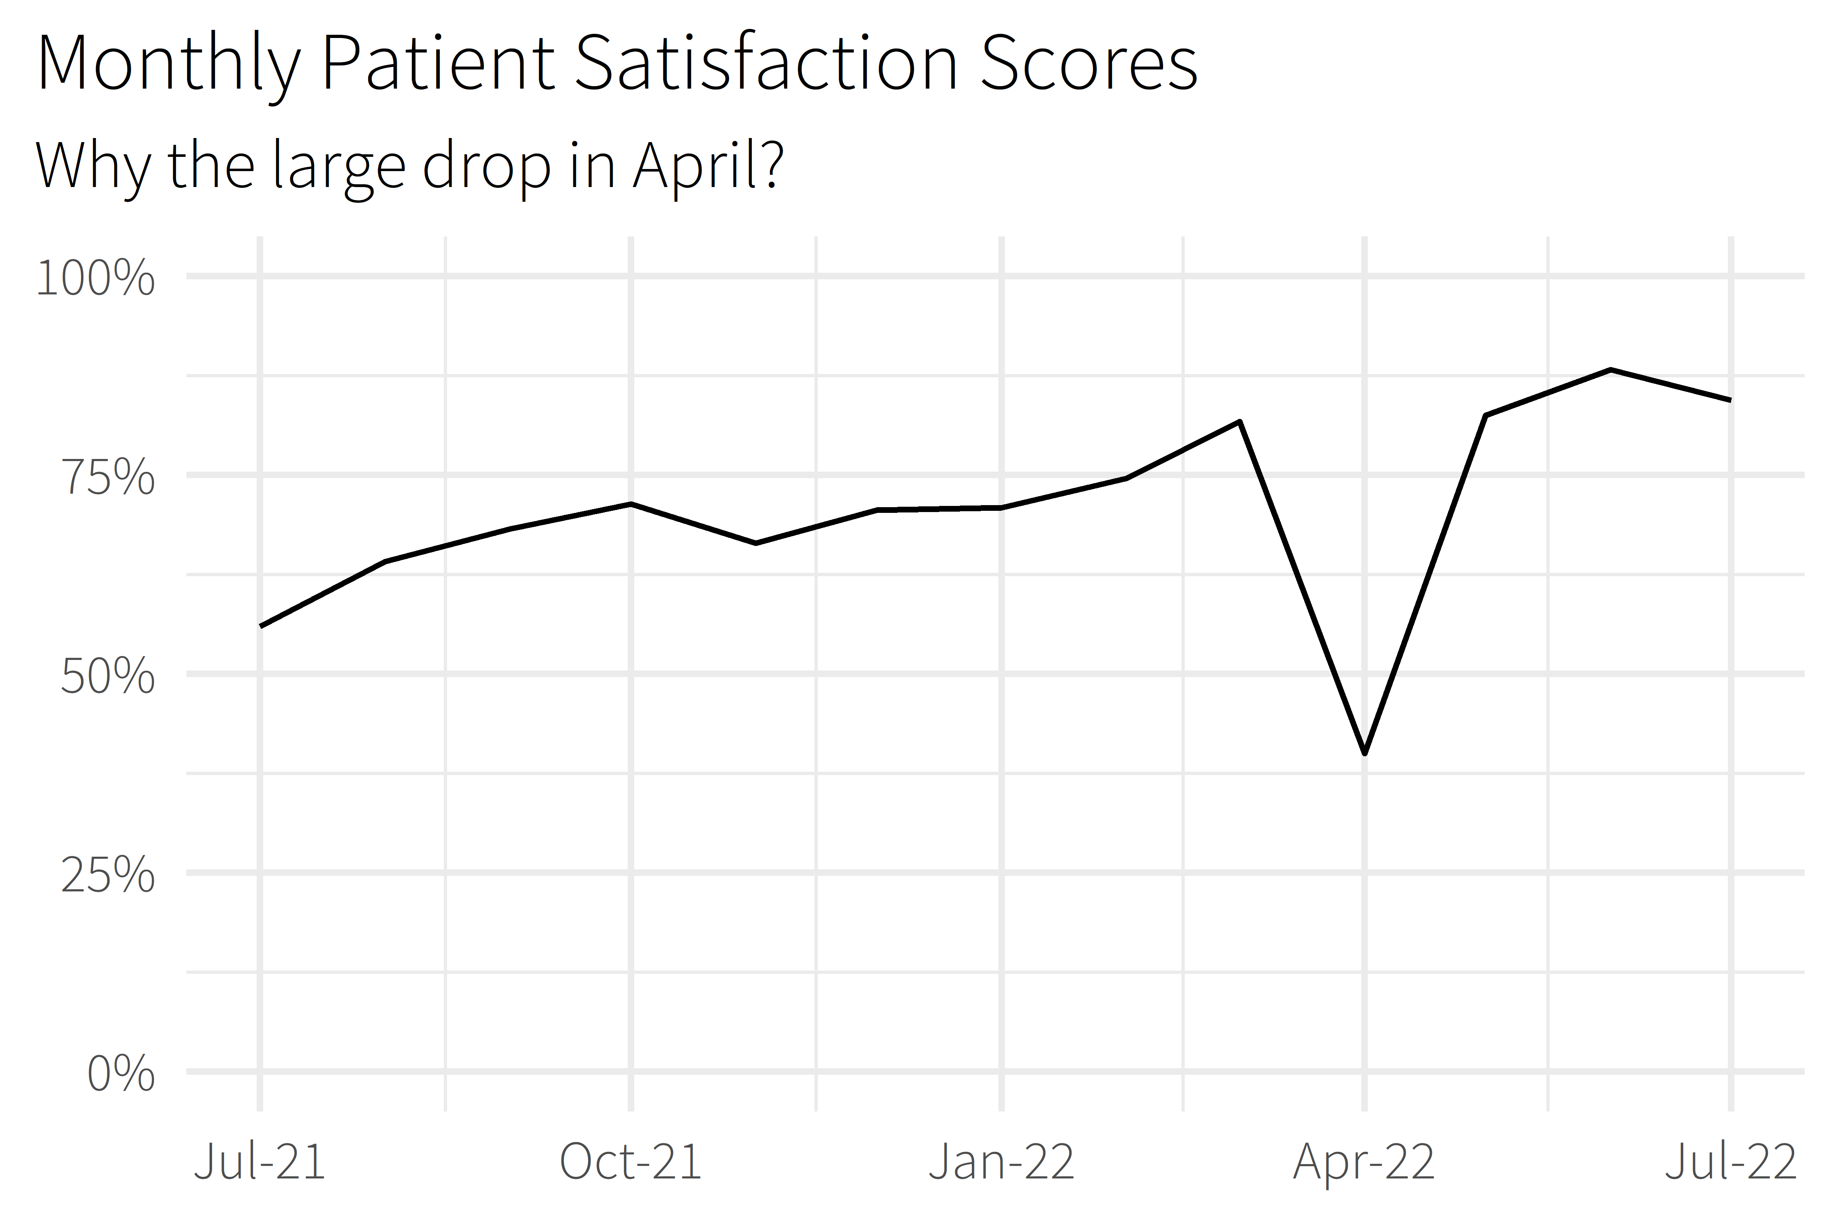
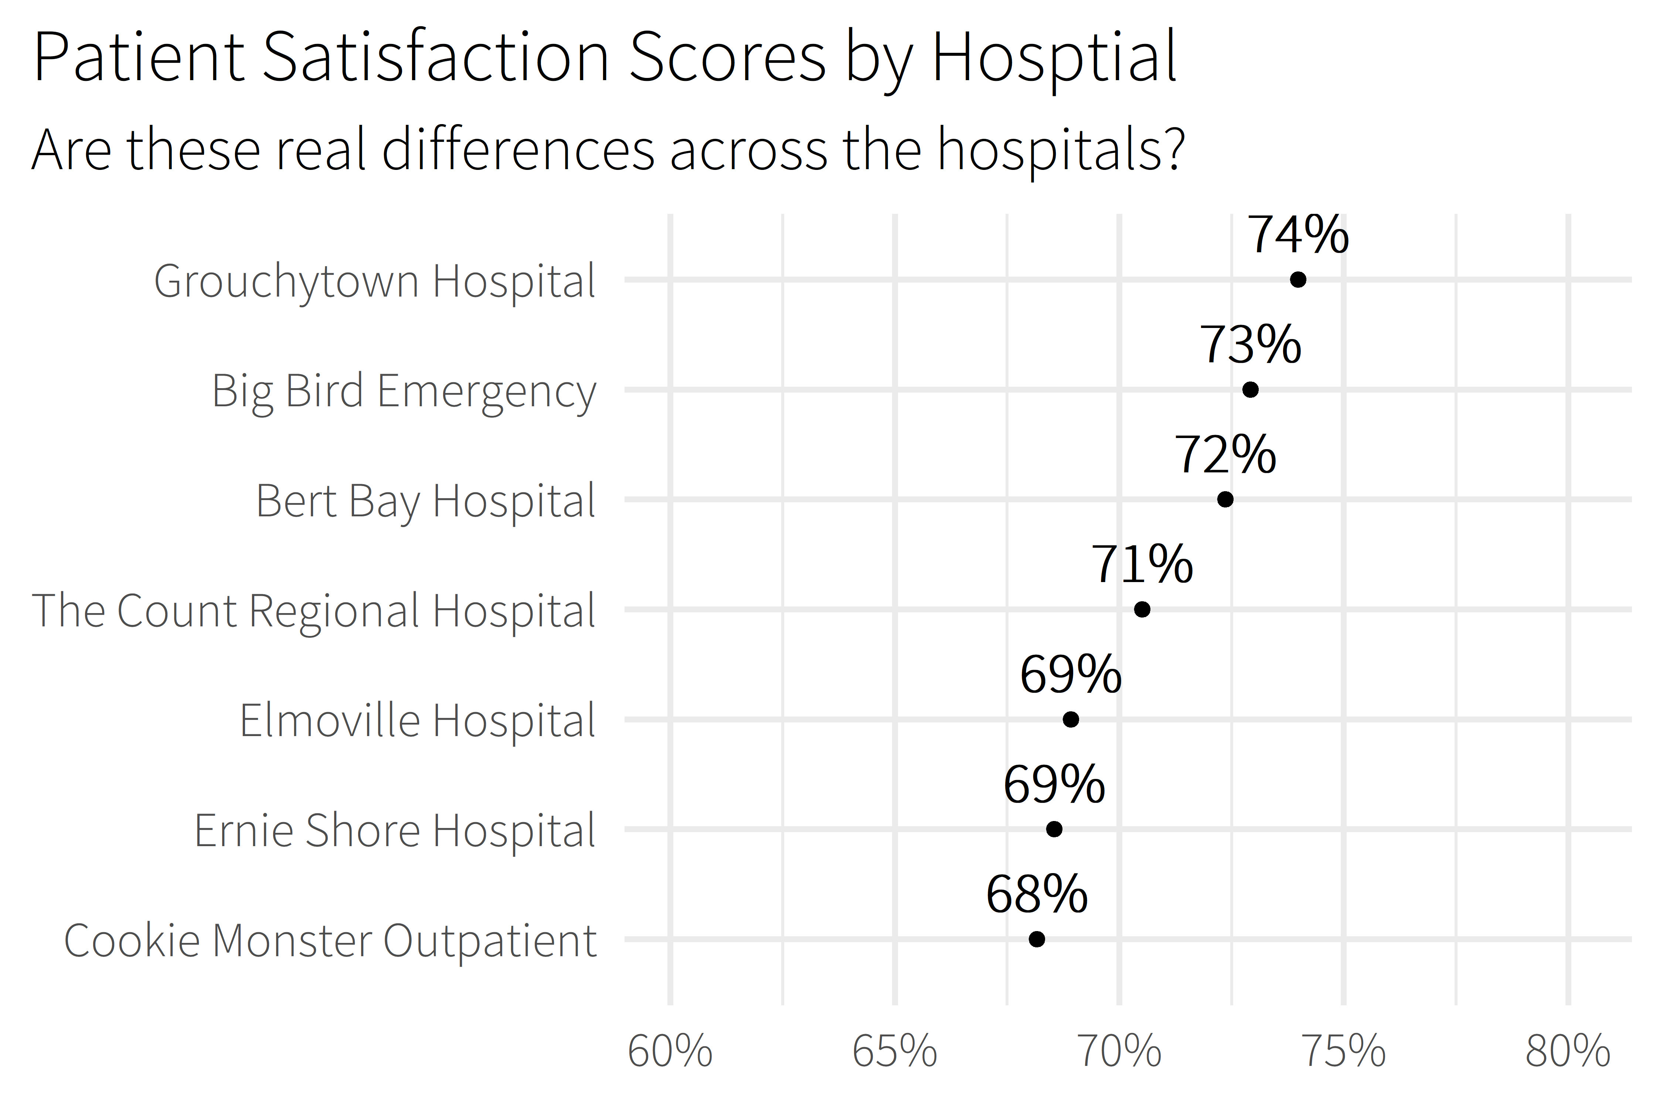
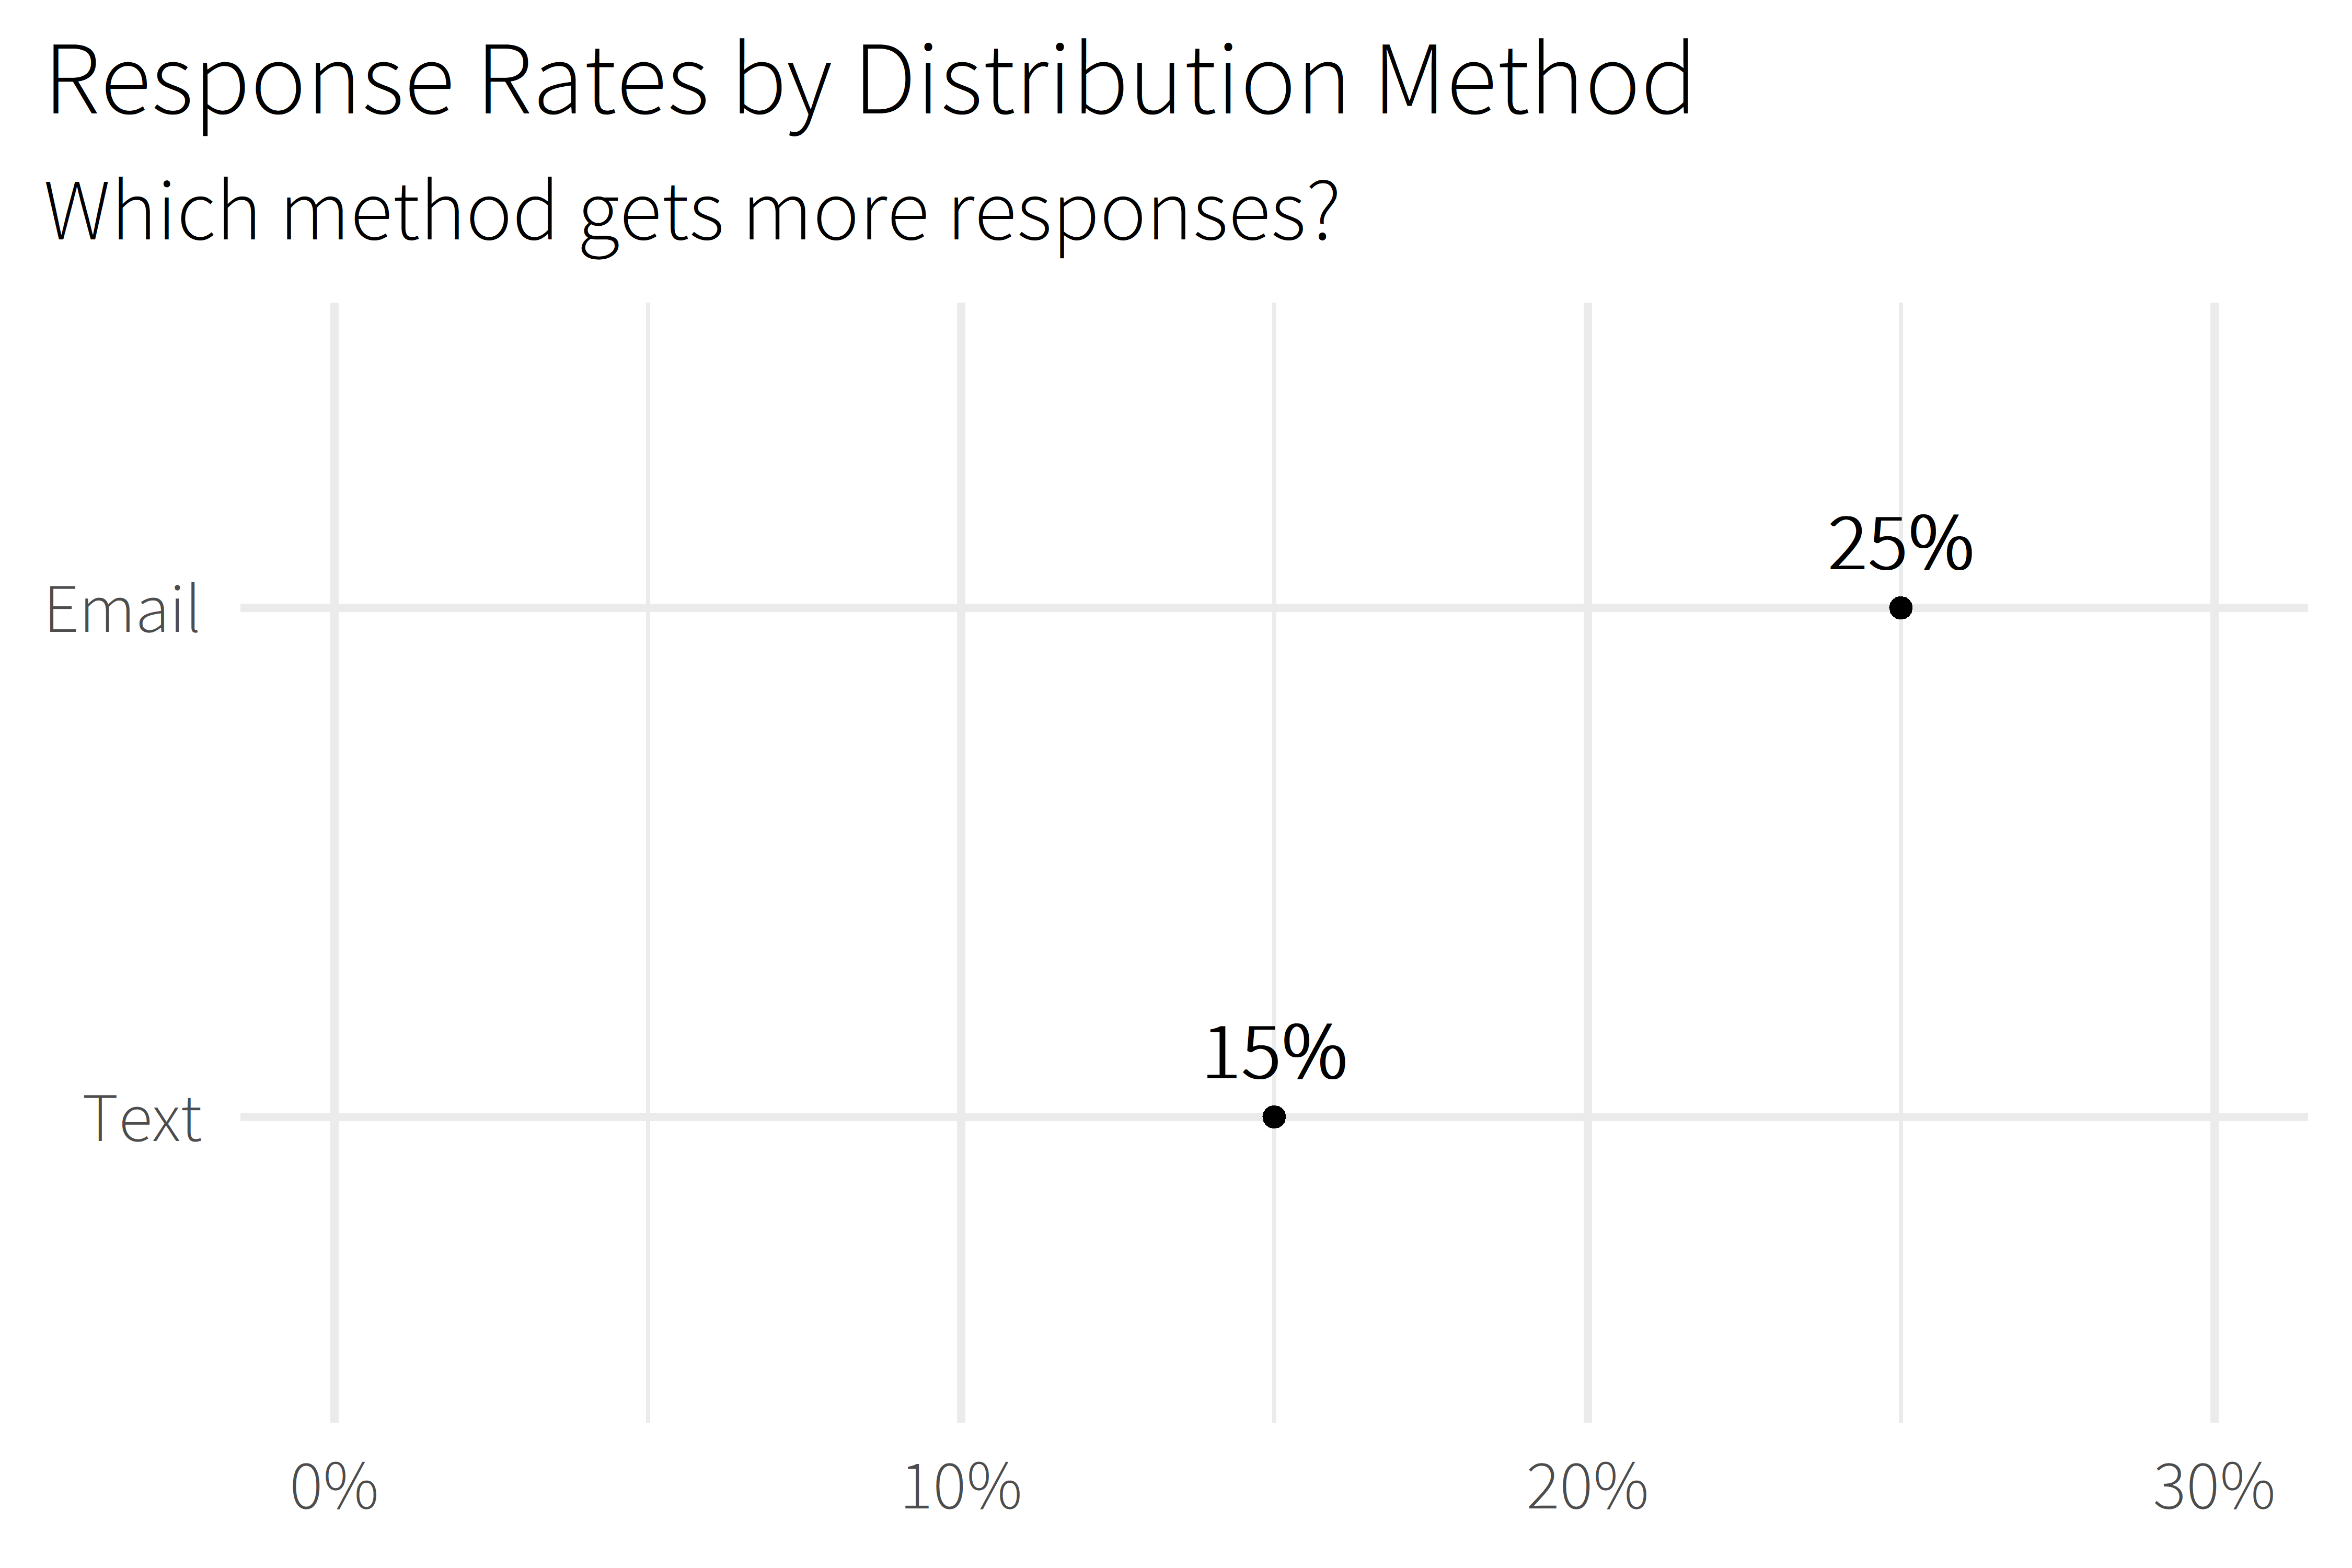

Slide 14
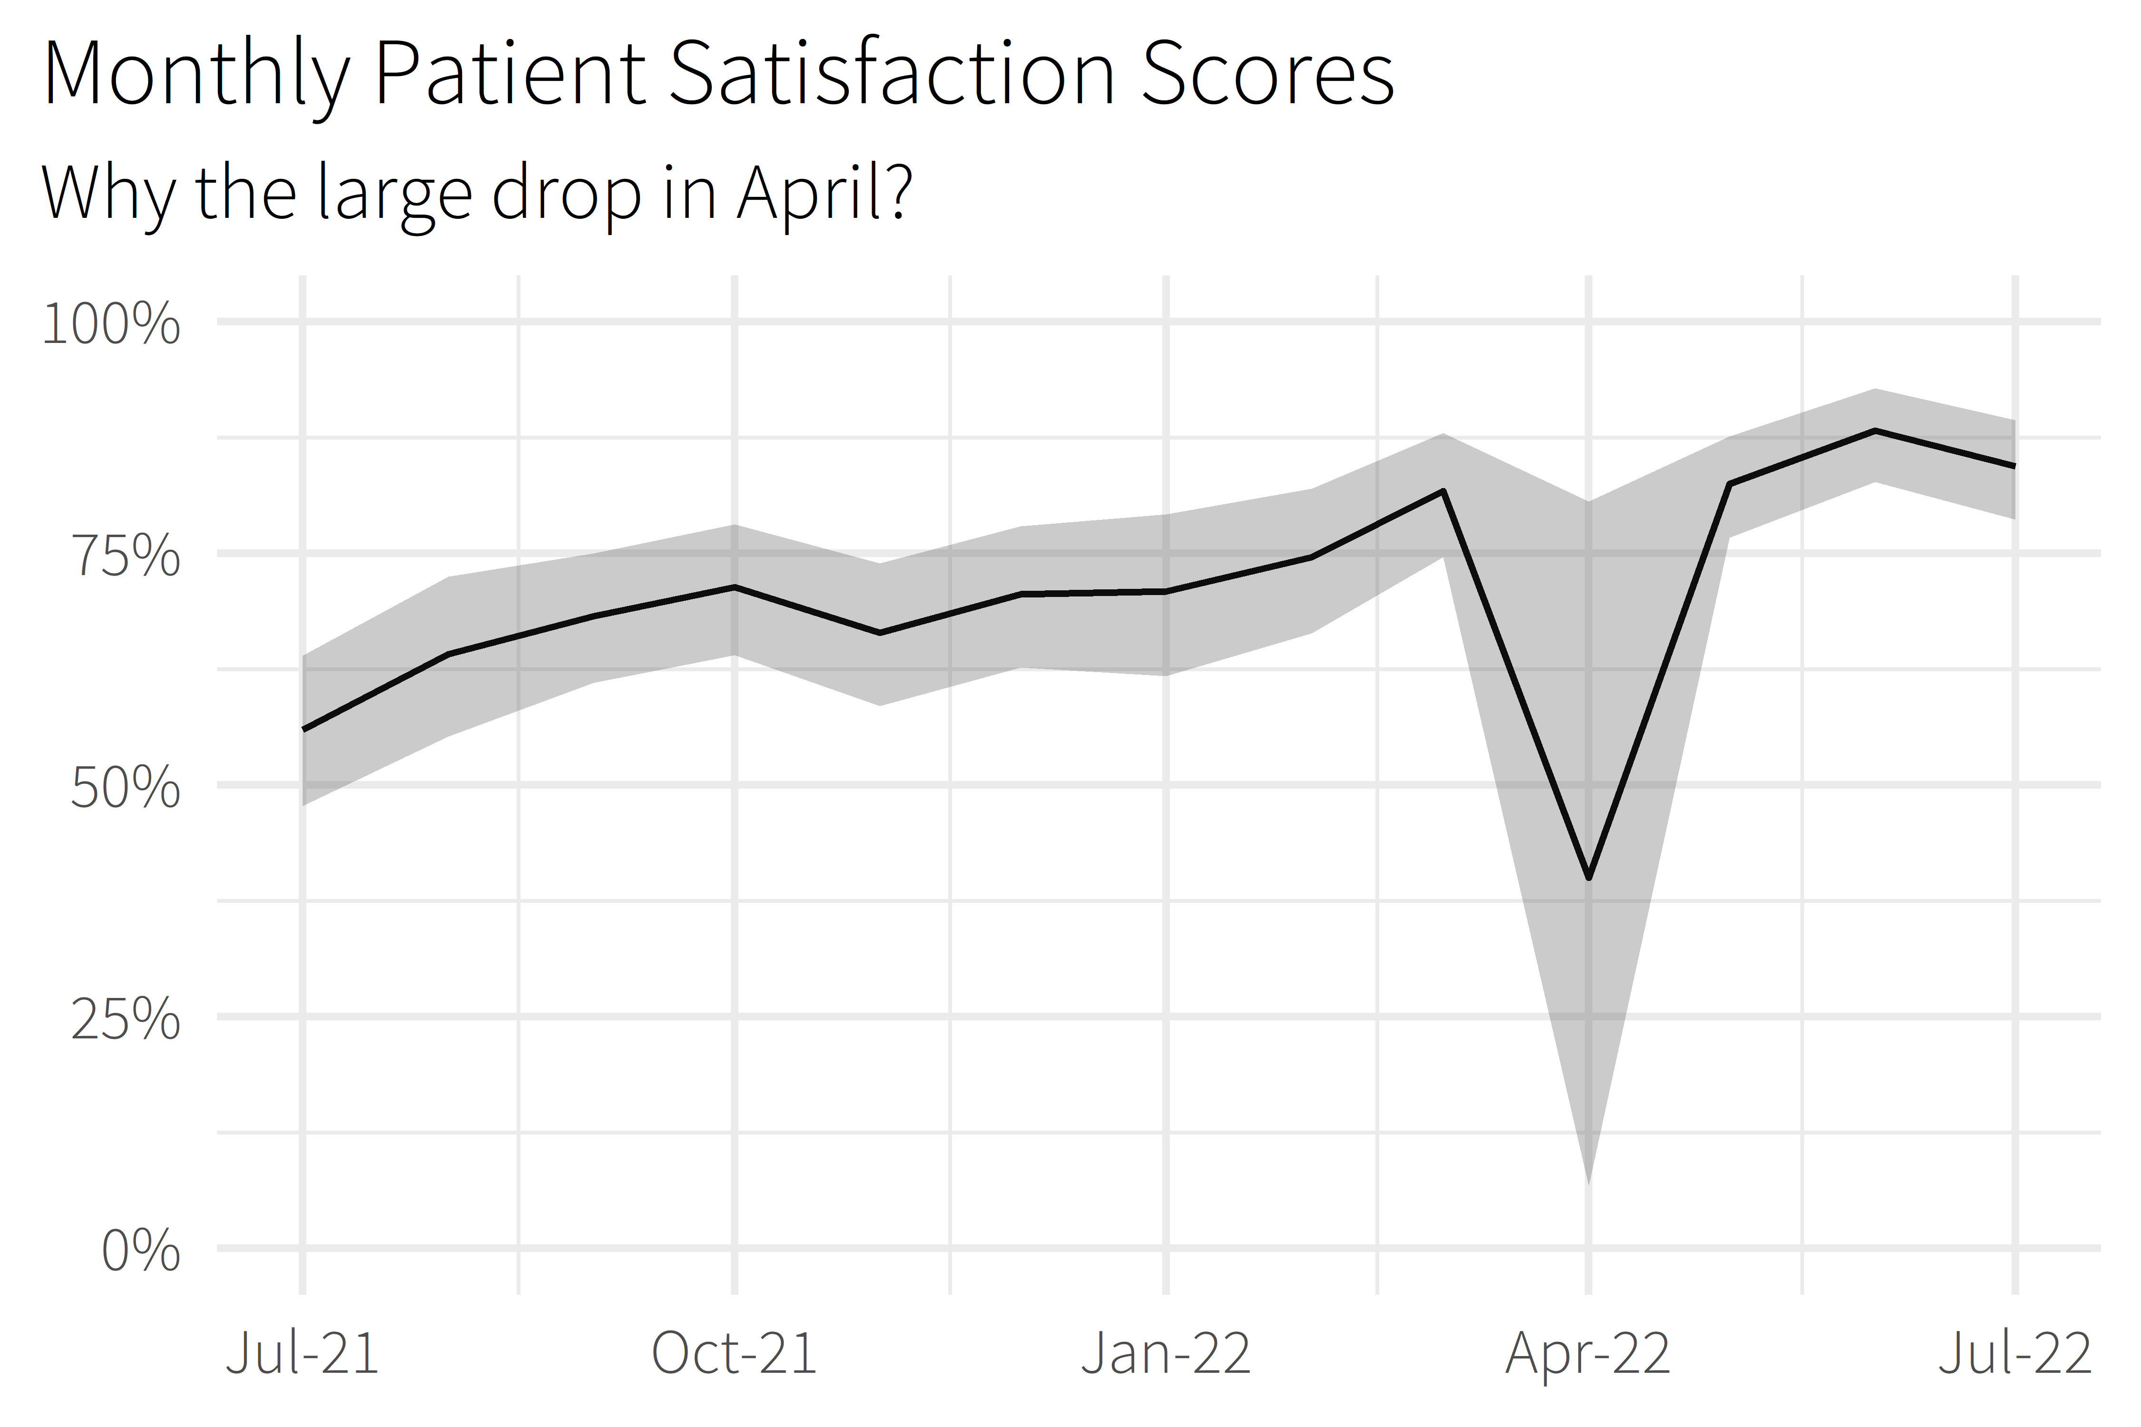

Slide 15
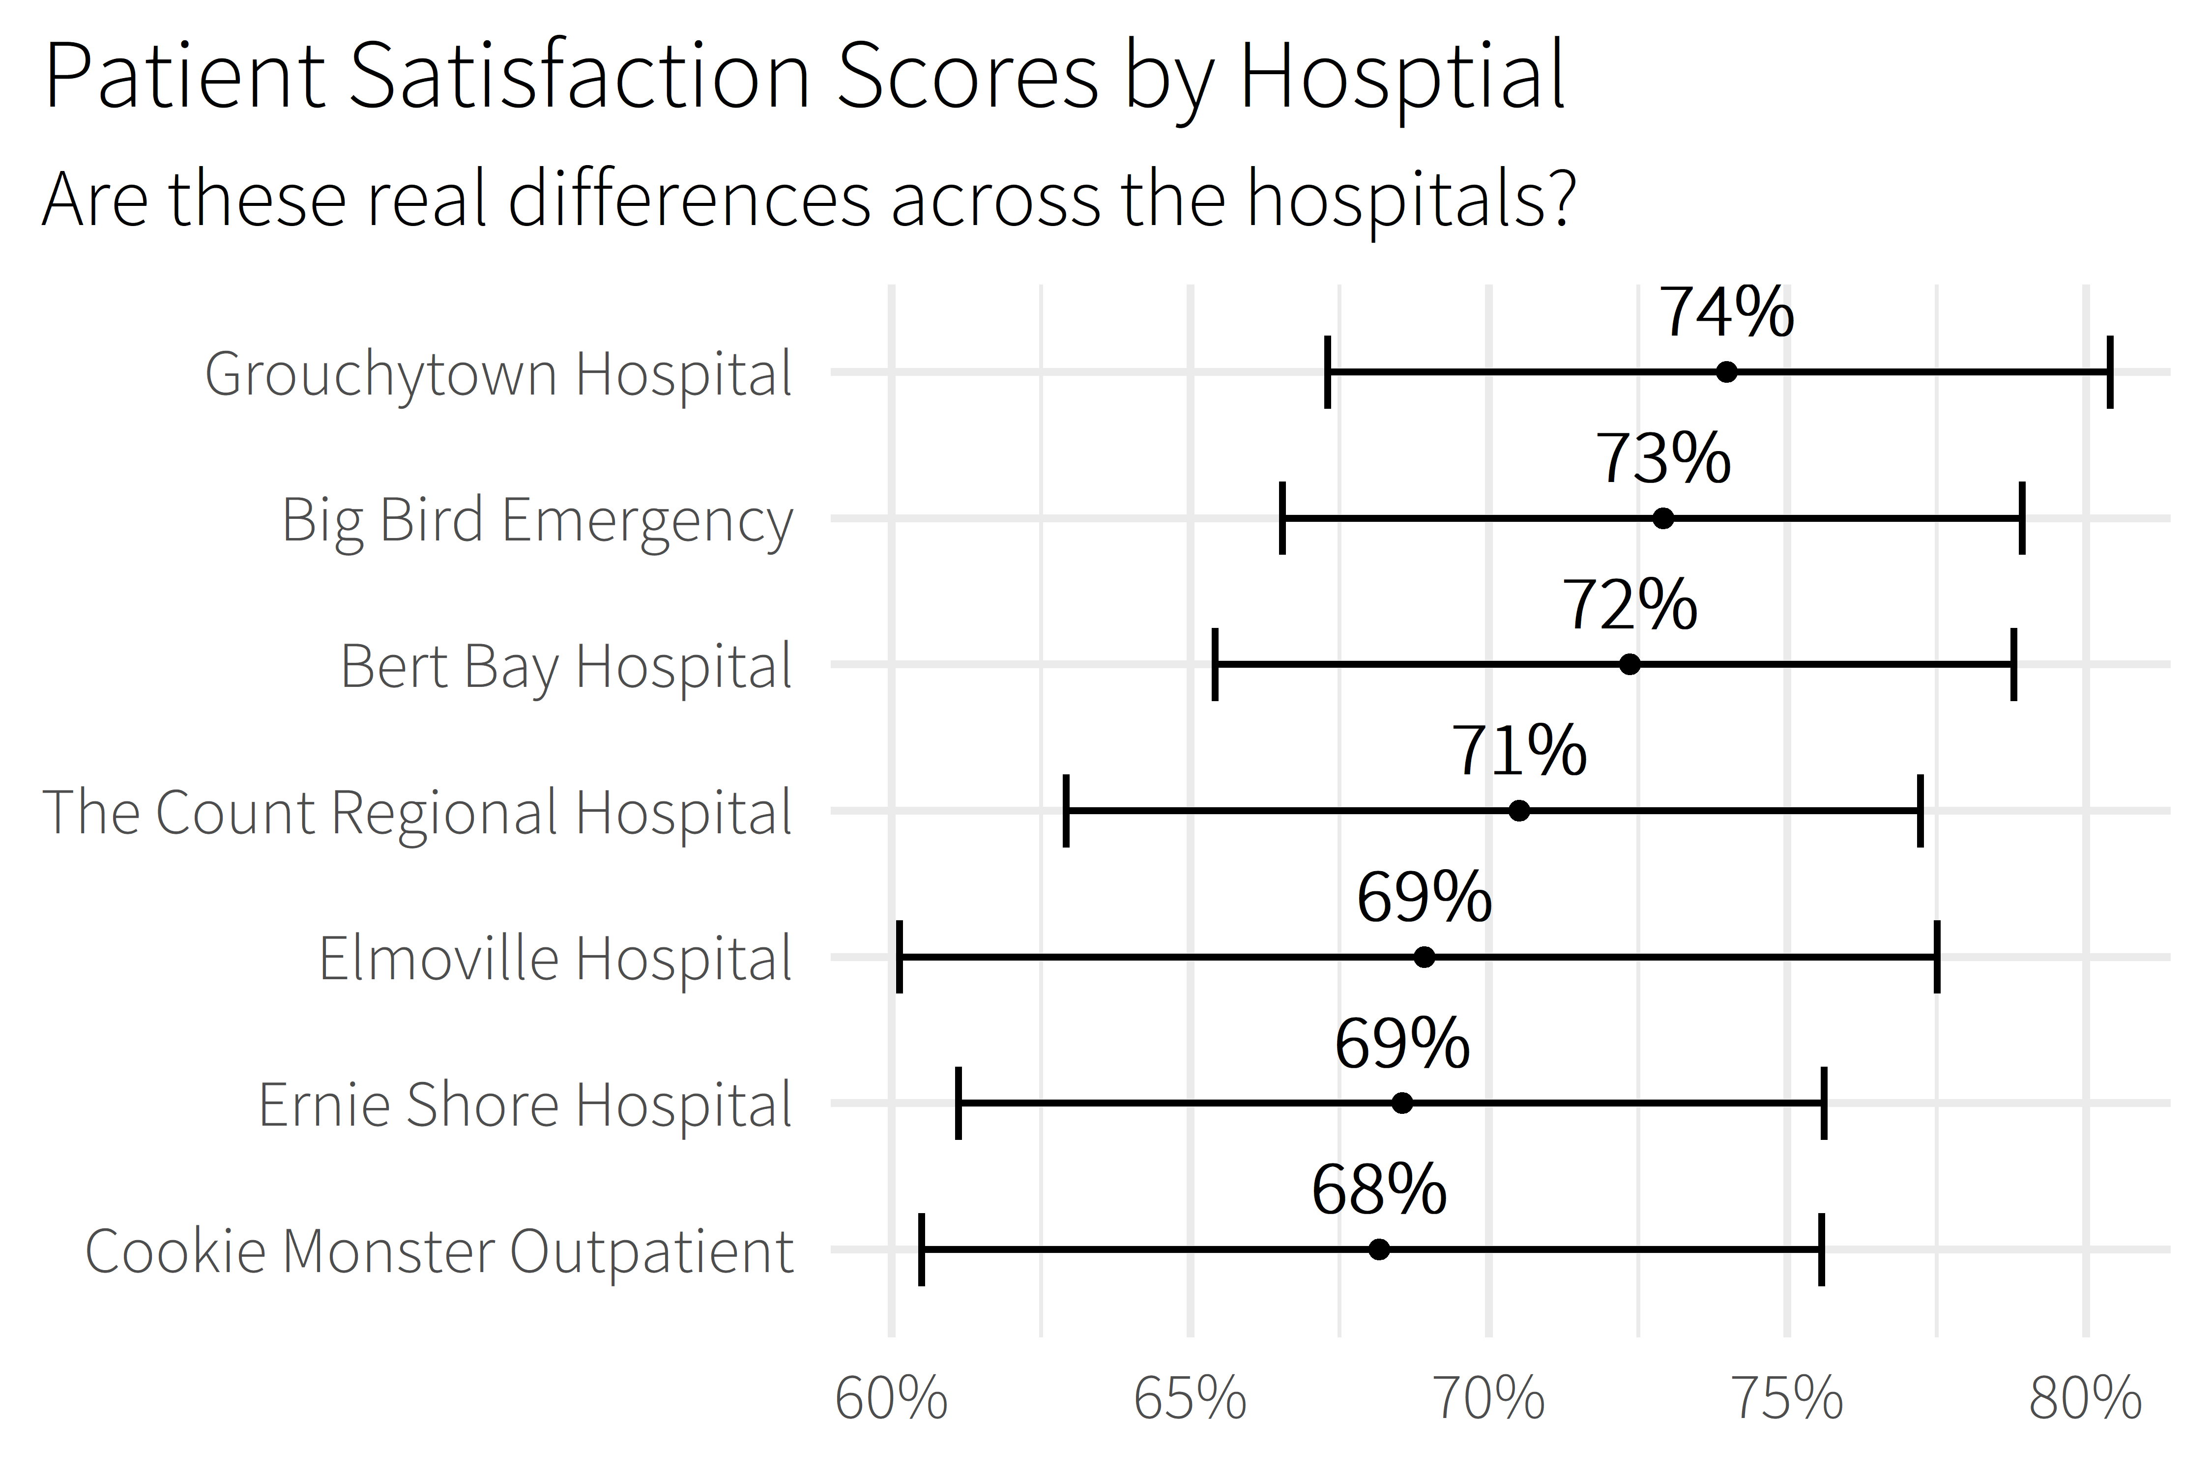

Slide 16
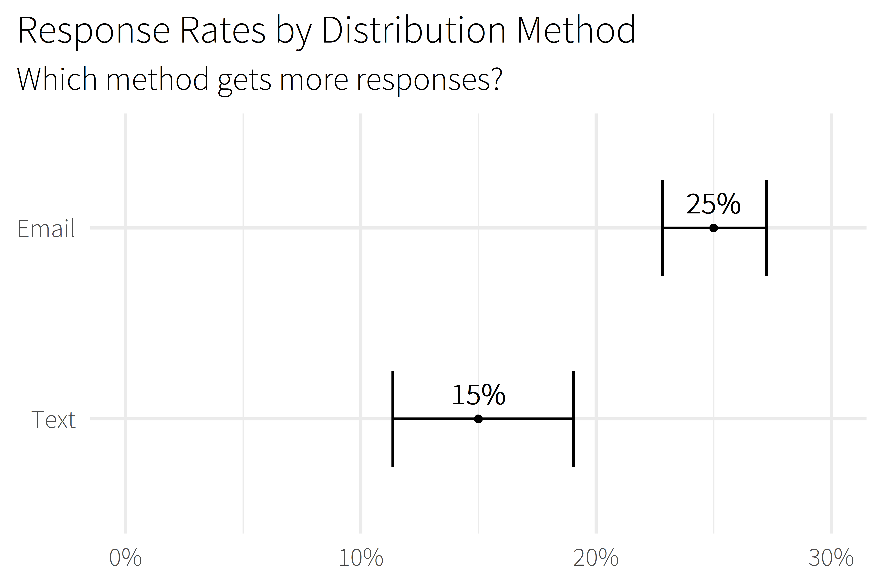

Slide 17

5.0 (19)
4.6 (2,280)

Slide 18
Package Overview

Slide 19
“how this works” section
where workboots sits in the model timeline
High-level review of bootstrapping
High-level review of methodology (train a bunch of models to get a bunch of possible outcomes)

Slide 20
using workboots
Set up a workflow
Generate predictions
Summarise results

Slide 21
set up a workflow
library(tidymodels)

Slide 22
set up a workflow
library(tidymodels)
# setup our data
data(“penguins”)
penguins <- penguins %>% drop_na()

Slide 23
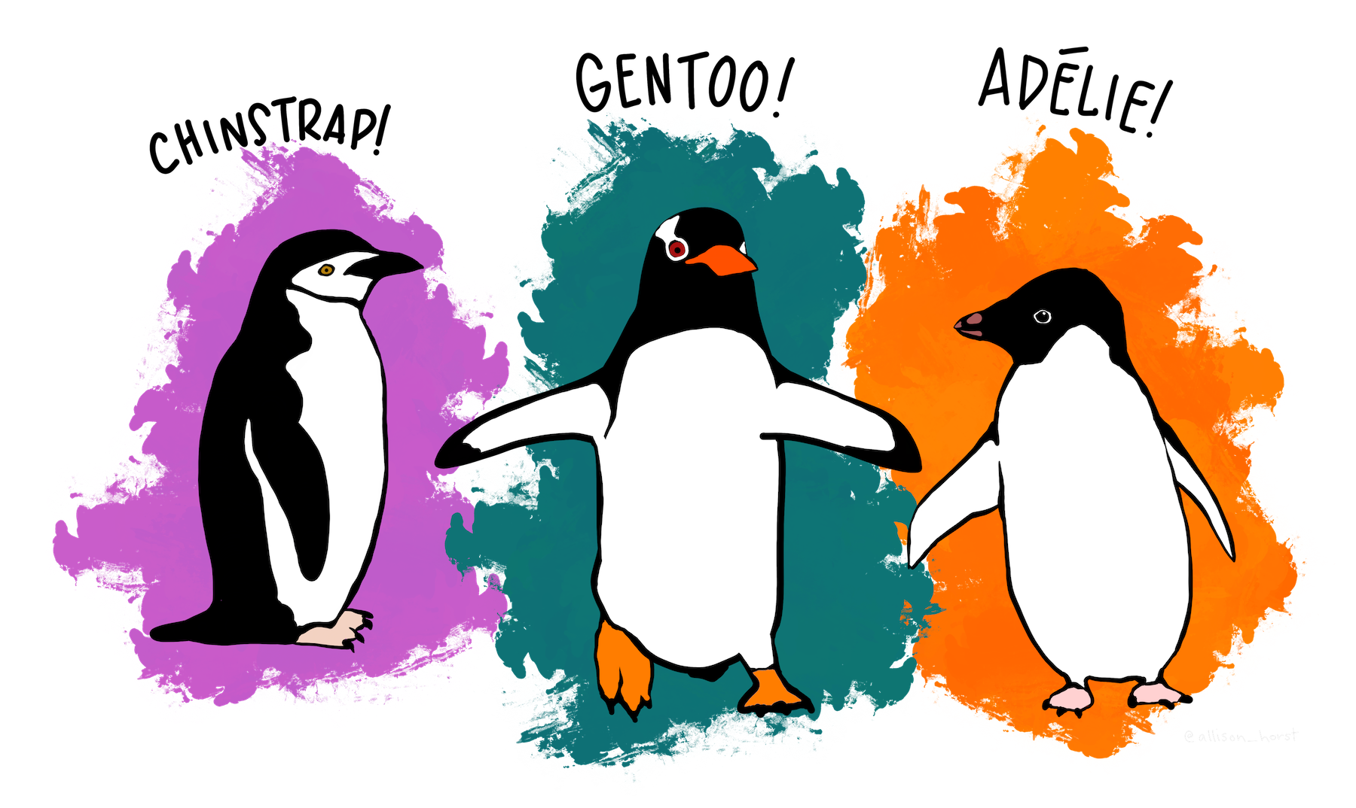
set up a workflow
library(tidymodels)
# setup our data
data(“penguins”)
penguins <- penguins %>% drop_na()

Slide 24
set up a workflow
penguins %>% glimpse()
#> Rows: 333
#> Columns: 7
#> $ species <fct> Adelie, Adelie, Adelie, ...
#> $ island <fct> Torgersen, Torgersen, To...
#> $ bill_length_mm <dbl> 39.1, 39.5, 40.3, 36.7, ...
#> $ bill_depth_mm <dbl> 18.7, 17.4, 18.0, 19.3, ...
#> $ flipper_length_mm <int> 181, 186, 195, 193, 190,...
#> $ body_mass_g <int> 3750, 3800, 3250, 3625, ...
#> $ sex <fct> male, female, female, fe...

Slide 25
set up a workflow
library(tidymodels)
# setup our data
data(“penguins”)
penguins <- penguins %>% drop_na()
set.seed(123)
penguins_split <- initial_split(penguins)
penguins_test <- testing(penguins_split)
penguins_train <- training(penguins_split)

Slide 26
set up a workflow
# setup a basic preprocessing recipe
penguins_rec <-
recipe(body_mass_g ~ ., data = penguins_train) %>%
step_dummy(all_nominal())

Slide 27
set up a workflow
# setup a basic preprocessing recipe
penguins_rec <-
recipe(body_mass_g ~ ., data = penguins_train) %>%
step_dummy(all_nominal())
# put together a workflow
penguins_wf <-
workflow() %>%
add_recipe(penguins_rec) %>%
add_model(boost_tree(“regression”))
Notes:
Notes
All tuning parameters finalized (in this case, we’re just using the defaults)
Workflow hasn’t been fit

Slide 28
generate predictions
library(workboots)

Slide 29

generate predictions
library(workboots)

Slide 30
generate predictions
library(workboots)
# generate a bootstrap prediction interval
set.seed(345)
penguins_preds <-
penguins_wf %>%
predict_boots(
n = 2000,
training_data = penguins_train,
new_data = penguins_test,
interval = “prediction”
)

Slide 31
generate predictions
library(workboots)
# generate a bootstrap prediction interval
set.seed(345)
penguins_preds <-
penguins_wf %>%
predict_boots(
n = 2000,
training_data = penguins_train,
new_data = penguins_test,
interval = “prediction”
)
Notes:
Number of bootstrap predictions to make

Slide 32
generate predictions
library(workboots)
# generate a bootstrap prediction interval
set.seed(345)
penguins_preds <-
penguins_wf %>%
predict_boots(
n = 2000,
training_data = penguins_train,
new_data = penguins_test,
interval = “prediction”
)
Notes:
Supply both our training data and new data in one step, since we’ll be fitting and predicting with one function call

Slide 33
generate predictions
library(workboots)
# generate a bootstrap prediction interval
set.seed(345)
penguins_preds <-
penguins_wf %>%
predict_boots(
n = 2000,
training_data = penguins_train,
new_data = penguins_test,
interval = “prediction”
)
Notes:
Supply both our training data and new data in one step, since we’ll be fitting and predicting with one function call

Slide 34
generate predictions
penguins_preds
#> # A tibble: 84 x 5
#> rowid .preds
#> <int> <list>
#> 1 1 <tibble [2,000 x 2]>
#> 2 2 <tibble [2,000 x 2]>
#> 3 3 <tibble [2,000 x 2]>
#> 4 4 <tibble [2,000 x 2]>
#> 5 5 <tibble [2,000 x 2]>
#> # ... With 79 more rows
Notes:
Returns a tibble with 2000 nested predictions for each observation. In this case, each row represents a penguin in the penguins_test dataset.

Slide 35
summarise results
penguins_preds %>%
summarise_predictions() %>% select(-.preds)
#> # A tibble: 84 x 5
#> rowid .pred .pred_lower .pred_upper
#> <int> <dbl> <dbl> <dbl>
#> 1 1 3465. 2913. 3994.
#> 2 2 3535. 2982. 4100.
#> 3 3 3604. 3050. 4187.
#> 4 4 4157. 3477. 4764.
#> 5 5 3868. 3305. 4372.
#> # ... With 79 more rows
Notes:
Returns a tibble with 2000 nested predictions for each observation. In this case, each row represents a penguin in the penguins_test dataset.

Slide 36
generate predictions
library(workboots)
# generate a bootstrap prediction interval
set.seed(345)
penguins_preds <-
penguins_wf %>%
predict_boots(
n = 2000,
training_data = penguins_train,
new_data = penguins_test,
interval = “prediction”
)

Slide 37
generate predictions
library(workboots)
# generate a bootstrap prediction interval
set.seed(345)
penguins_preds <-
penguins_wf %>%
predict_boots(
n = 2000,
training_data = penguins_train,
new_data = penguins_test,
interval = “prediction”
)
Notes:
By default, predict_boots() will generate a prediction interval

Slide 38
generate predictions
library(workboots)
# generate a bootstrap prediction interval
set.seed(345)
penguins_preds <-
penguins_wf %>%
predict_boots(
n = 2000,
training_data = penguins_train,
new_data = penguins_test,
interval = “confidence”
)
Notes:
But we can also generate

Slide 39
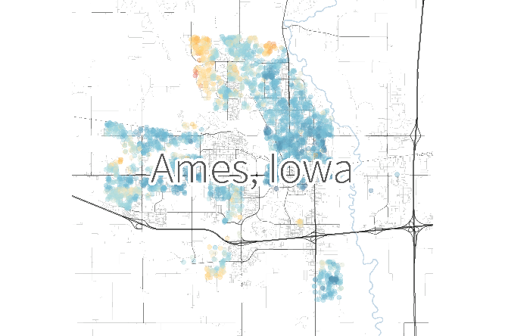
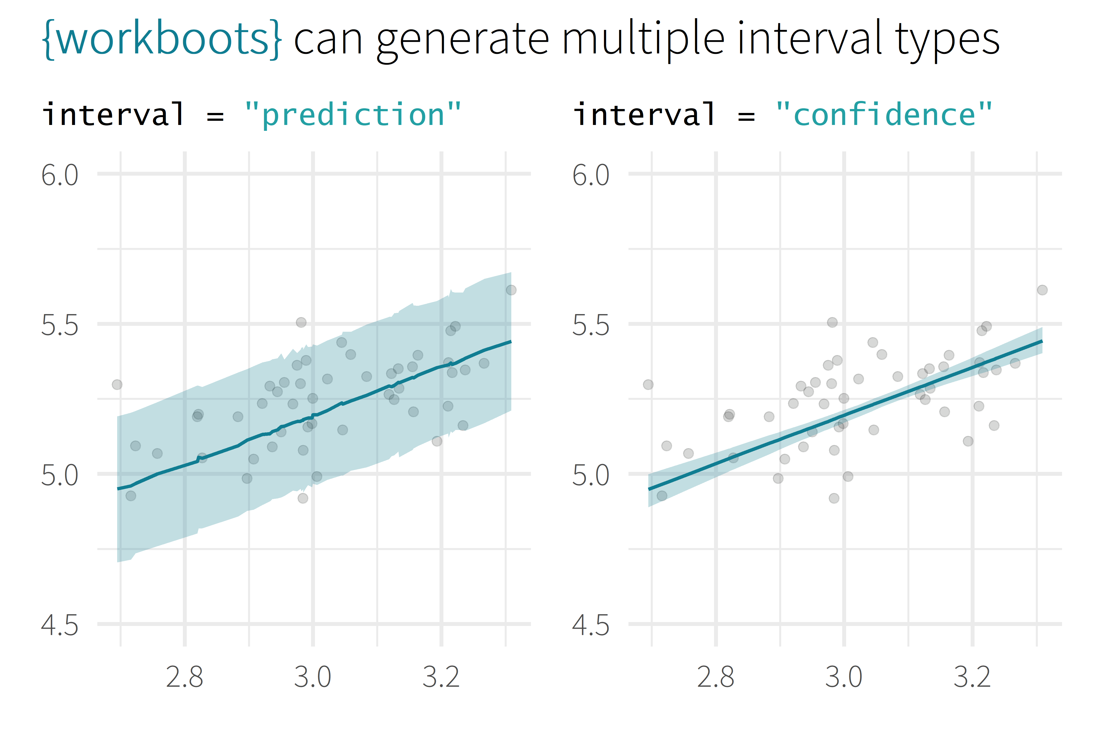
Remember to give a description of Ames dataset:
Predicting the price of a home’s sale price in Ames, Iowa
log10(Sale_Price)
log10(First_Flr_SF)

Slide 40
generate importances
# generate a bootstrap variable importances
set.seed(345)
penguins_vi <-
penguins_wf %>%
vi_boots(
n = 2000,
training_data = penguins_train
)
Remind people what feature importance is:
Methods of measuring feature importance vary depending on model type
More important features have a greater impact on the model’s prediction

Slide 41
generate importances
penguins_vi
#> # A tibble: 8 x 2
#> variable .importances
#> <int> <list>
#> 1 flipper_length_mm <vi [2,000 x 2]>
#> 2 species_Gentoo <vi [1,928 x 2]>
#> 3 bill_length_mm <vi [2,000 x 2]>
#> 4 bill_depth_mm <vi [2,000 x 2]>
#> 5 sex_male <vi [2,000 x 2]>
#> # ... With 3 more rows

Slide 42
summarise importances
penguins_vi %>%
summarise_importance() %>% select(-.importances)
#> # A tibble: 8 x 2
#> variable .importance .importance_lower
#> <int> <dbl> <dbl>
#> 1 flipper_length_mm 0.464 0.254
#> 2 species_Gentoo 0.402 0.044
#> 3 bill_length_mm 0.045 0.027
#> 4 bill_depth_mm 0.040 0.024
#> 5 sex_male 0.046 0.020
#> # ... With 3 more rows, and 1 more variable:
#> # .importance_upper <dbl>

Slide 43
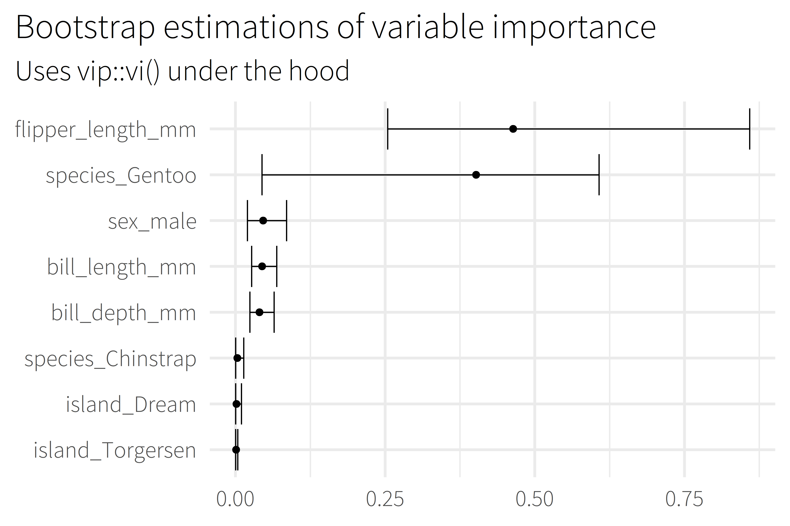
Talk about the features themselves, e.g.,
According to this model, the length of a penguin’s flipper is way more important to figuring out their weight than which island the penguin comes from
Notes:
Uses the vip package under the hood to estimate model-specific importance.
Some model types aren’t supported by vip

Slide 44
Call to action (use my package plz)
Closing
Links, acknowledgements, resources

Slide 45
Backup

Slide 46
overview
Selling Point
About me
Motivation / Background
Package overview
Cost of doing business
(1 min)
(2 min)
(5 min)
(5 min)
(5 min)

Slide 47
“I use R and tidymodels to provide actionable insight from patient survey data.”

Slide 48
What is the range of possible outcomes?
How important is each variable in the model?

Slide 49

lm()
me
XGBoost

